Slide 1

Welcome to First Grade!
Evelyn Scarborough Elementary School

Slide 2

Curriculum
Based on Texas Essential Knowledge and Skills (TEKS)
Reading
Language Arts
Math
Science/Social Studies
Specials Classes
  PE, Music, Computers, Art

Slide 3
Grading
Daily grades and attendance will be available on Parent Connection
Children will be graded on:
-Daily Work
-Special Projects
- Assessments
- Citizenship

Slide 4
Grading Policy
Grades are based on student progress of the Texas Essential Knowledge and Skills (TEKS).
E | Excellent | WOW! I have mastered the concept. I know the concept so well, I can teach it to someone else consistently. I can explain the concept in two or more ways. I can be given more depth and extension activities on this concept.
S | Satisfactory | I am grasping the concept. I have a general understanding of the skill. I am still practicing, but I have not mastered the concept.
N | Needs Improvement | I need my teacher to reteach the concept to me in small group in a different way. I am making some progress.
U | Unsatisfactory | I do not understand the concept at all. I am not able to perform any part of the task. I am making little or no progress. I am not meeting the standard.
Teachers do not give grades. Students earn grades. Grades are not based on effort. Effort will be noted under Citizenship and Work Habits on report cards.

Slide 5
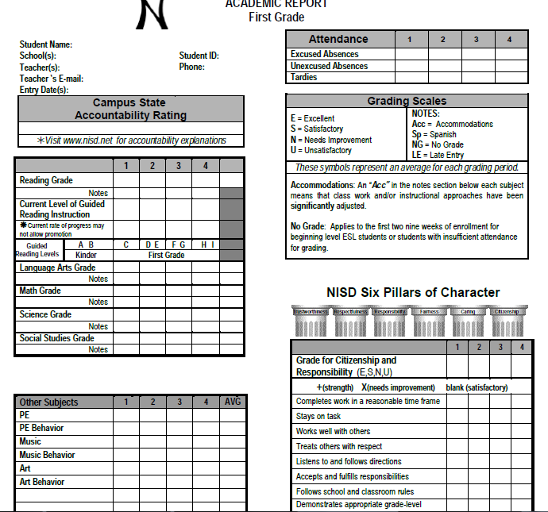

Slide 6
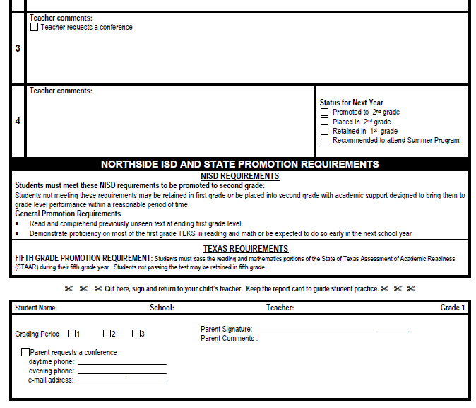

Slide 7
Please Sign Up For Parent Connection. Step by Step Directions Can Be Found On My Website☺
You will be able to see your child’s grades and their progress!

Slide 8
Arrival
No earlier than 7:00 a.m.
-If students arrive before 7:30 they will sit in the first grade hallway.
No later than 7:45 a.m. in the classroom
After 7:45 a.m. = Tardy (office tardy slip)
After 9:00 a.m. = Absence

Slide 9
Absences
Note needed upon return from absence to include:
- Date of note
- Name of child
- Date of absence or Tardy
- Specific Reason
- Parent Signature
-Child’s ID Number
Only the office can change UA to EA

Slide 10
Absence Form

Slide 11
School & Home Communication
Blue Daily Folder – Please Initial Daily
Mid-quarter Signed Progress Reports
Conferences
Classroom Newsletter
Student work
Remind
Email

Slide 12
Daily Blue Folder
Sign and return daily!
Keep daily work at home
Return papers that need to be completed
Plastic sleeve – Words to Know & Math Chart

Slide 13
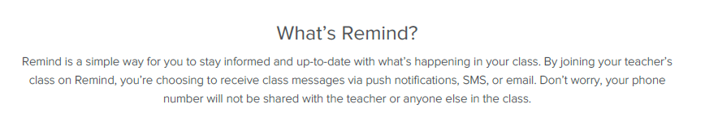

Slide 14
Student Expectations
Homework
Memorization of Math Facts and Sight Words
Daily Independent Reading
Exemplary Behavior
Organization
Be Proactive

Slide 15
Homework
Sent home Mondays and return on Friday
  In the red homework folder
  15 minutes per day
  read 10-20 minutes nightly (Log it on the Huskies PAWS for Reading Sheet)
Reading, Spelling, Math, Writing/Handwriting
Use pencil only unless specified
Sight Word Tests on Friday!

Slide 16
Snacks
Students may bring a healthy snack daily to school
Snack will be around 9:30 a.m.
Water only

Slide 17
Cafeteria
You may add money to your child’s account on-line.
1st grade students may purchase “treats” on Fridays only.

Slide 18
Background Checks
Required for
-Field Trip Chaperones
-All PTA Board Members
- All PALS
- All Room Parents
- Anyone that will be in the classroom working with students at anytime.
Online form available at www.nisd.net

Slide 19
Birthday Celebrations
You may send store bought cupcakes/cookies to be eaten after lunch during our recess.
Invitations
-must include all students if distributing at school.

Slide 20
Field Trips
(TBA) The DoSeum
Parents must have a criminal background check if planning to attend as a chaperone.

Slide 21

Thank you for your support!
Together, we’ll make this a great year for your child!
Remember:
Leading by Example…
It’s the Husky way!

